Slide 1
✍Mastering (oop) using c++
✍Lecture_1 :
Intro to oop
Encapsulation
Inheritance
Polymorphism
Complex class example
✍Lab_1

Slide 2
✍Mastering (oop) using c++
✍Lecture 2 :
Default Arguments
Polymorphism (overloading functions )
Constructor & Destructor
This pointer
Stack example
Static members
✍Lab2 .

Slide 3
✍Mastering (oop) using c++
✍Lecture 3 :
Friend Function .
Pass objects to functions .
Dynamic Area problems .
Dynamic Area problem(solutions).
✍Lab3 .

Slide 4
✍Mastering (oop) using c++
✍Lecture 4 :
Equal Operator Overload for Stack.
Operators Overload for Complex .
✍Lab4 .

Slide 5
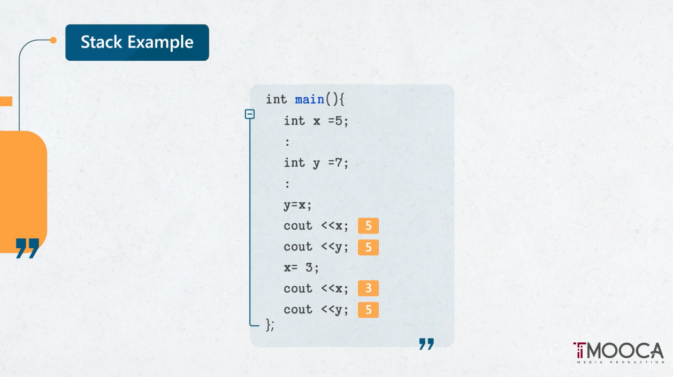

Slide 6
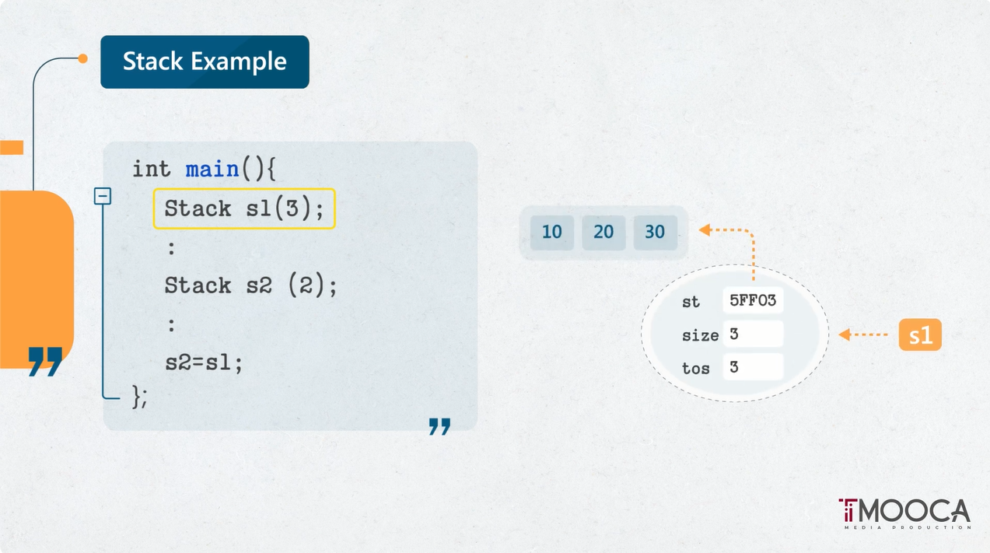

Slide 7
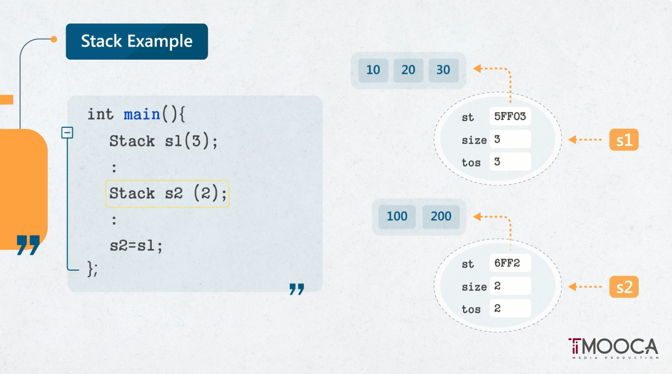

Slide 8
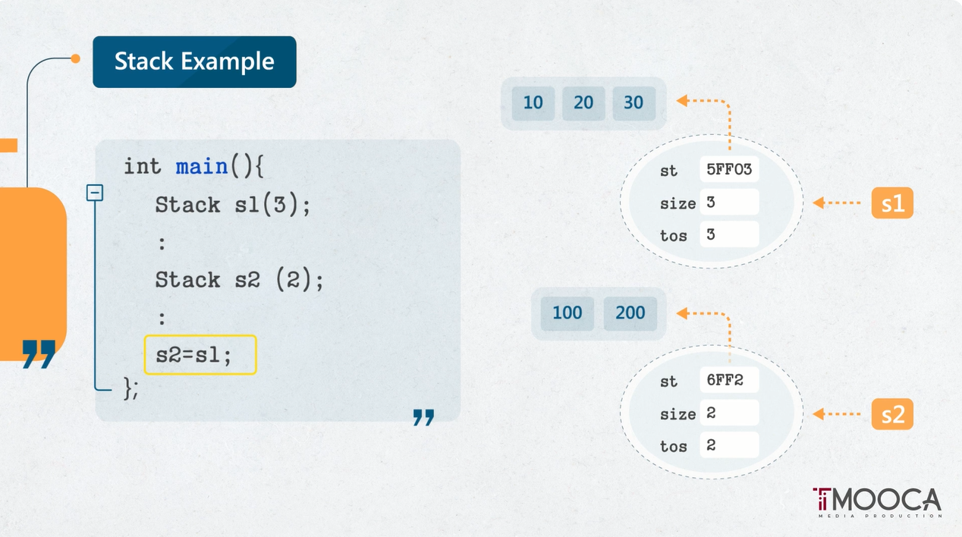

Slide 9
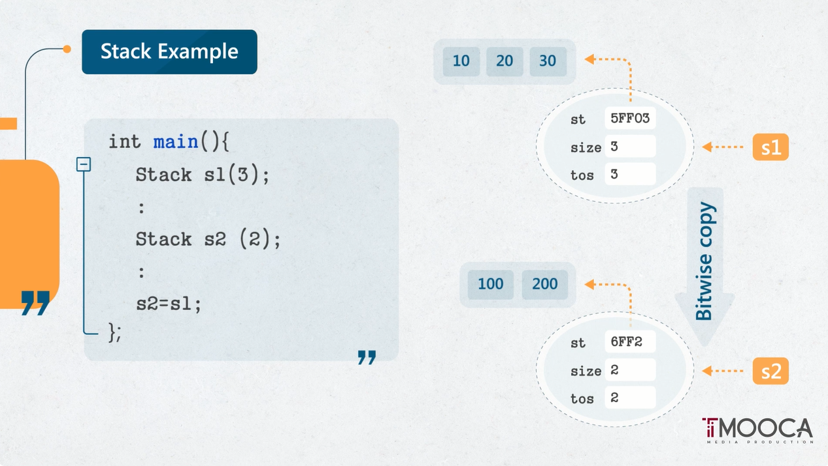

Slide 10
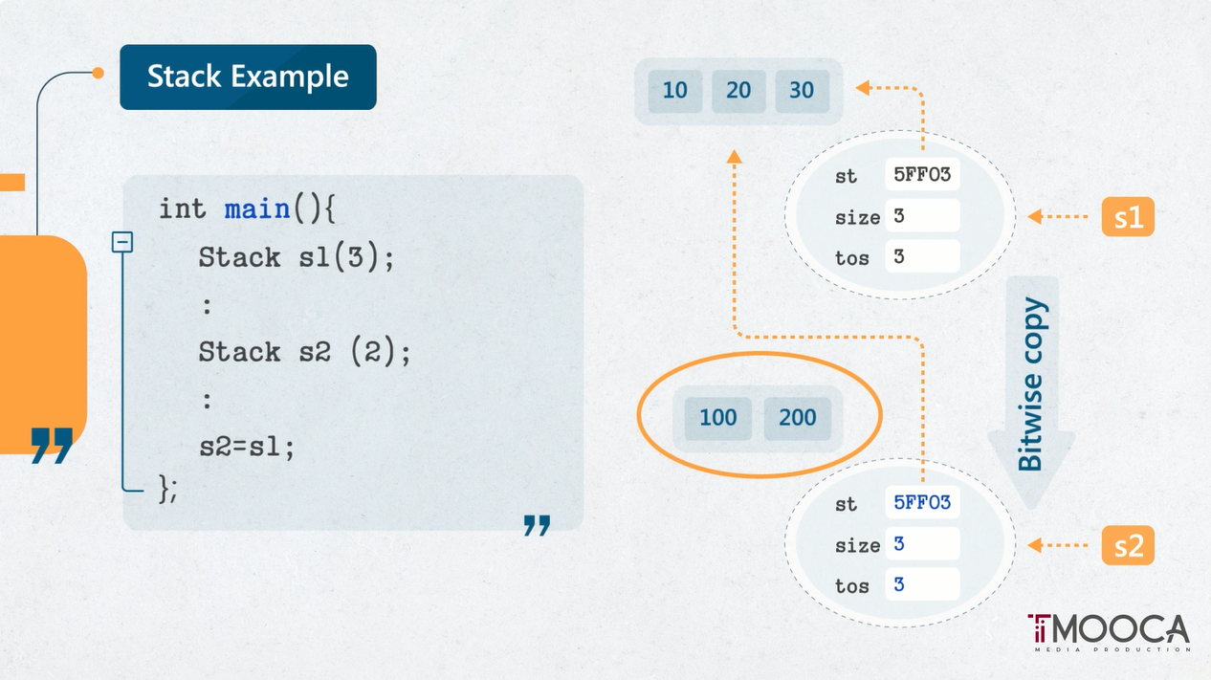

Slide 11
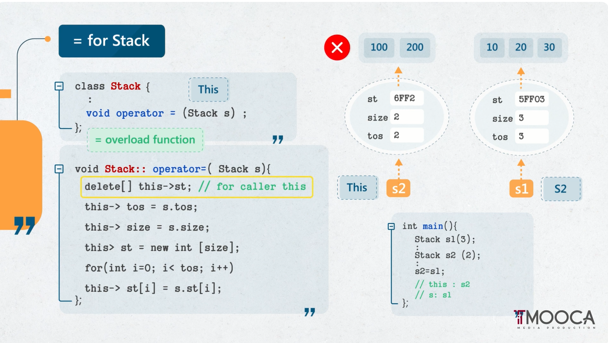

Slide 12
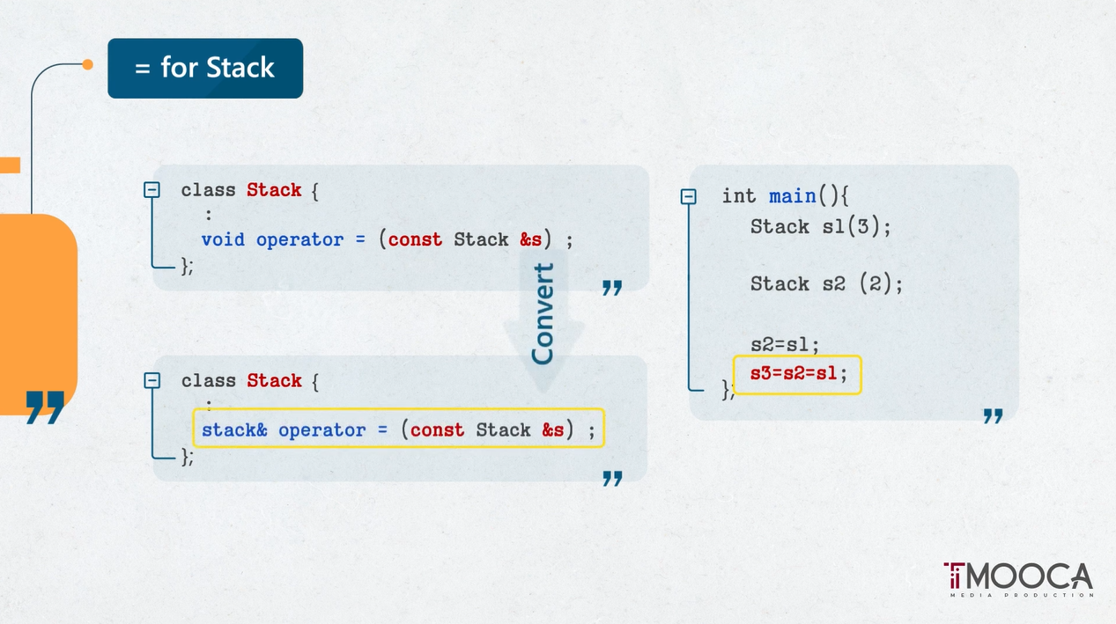

Slide 13
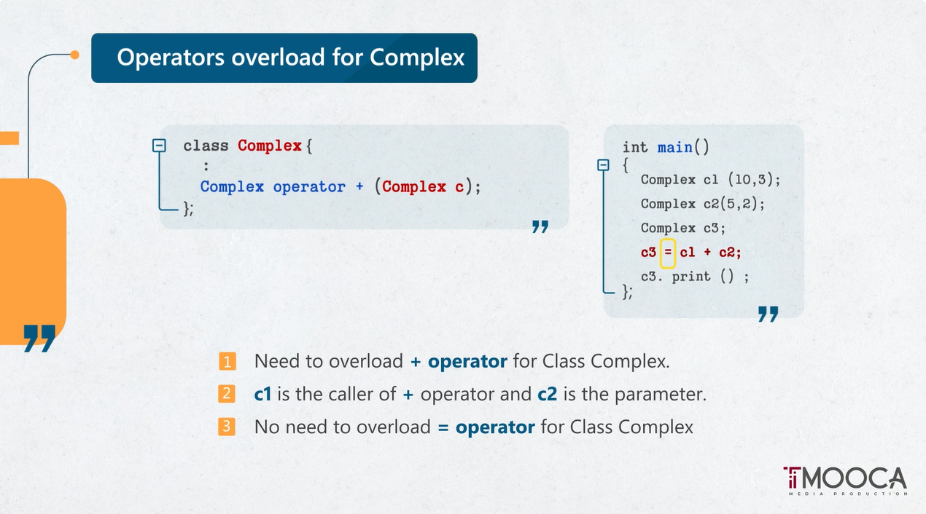

Slide 14
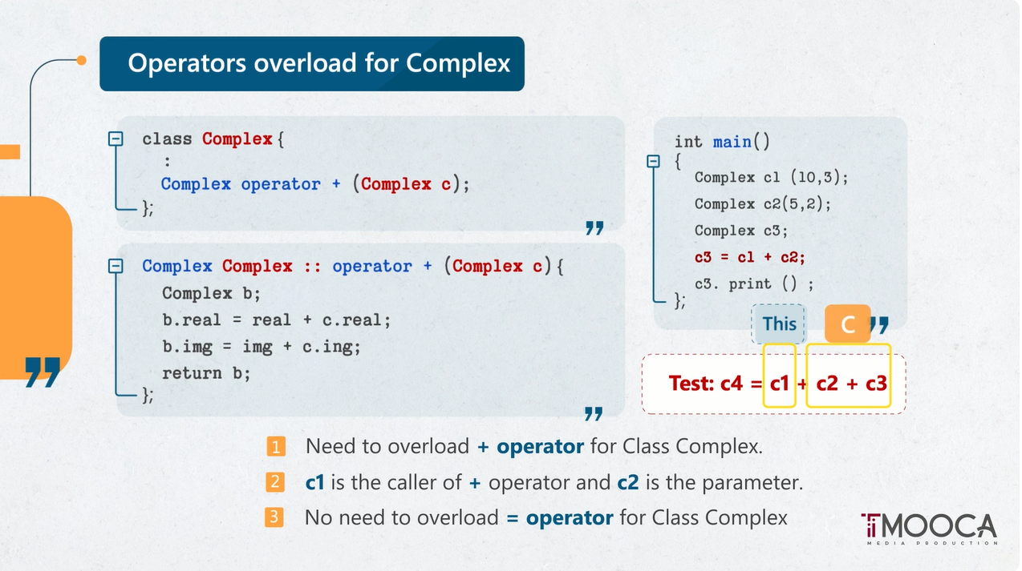

Slide 15
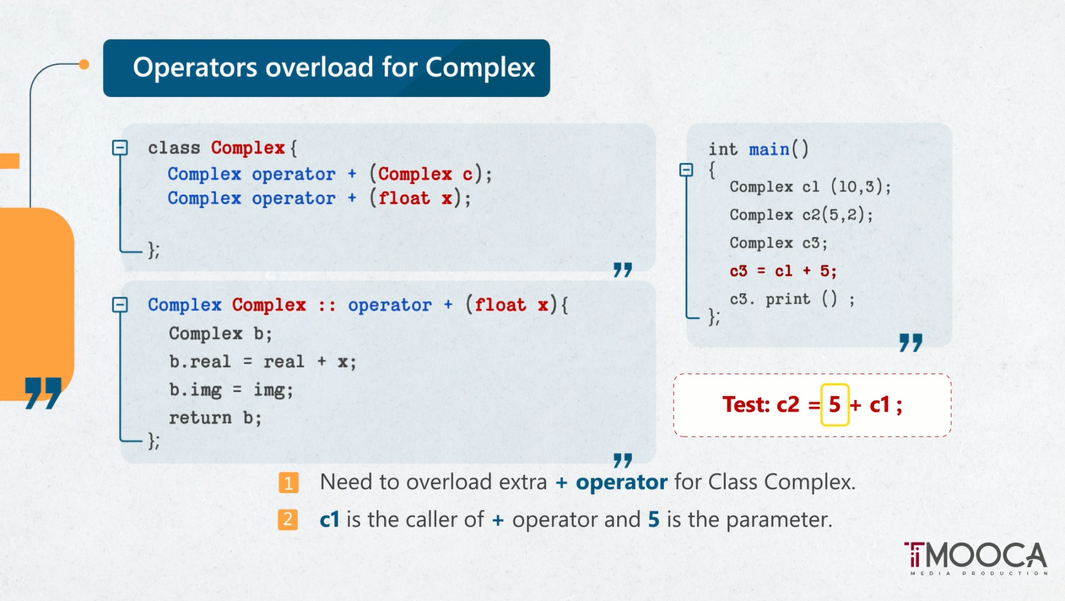

Slide 16
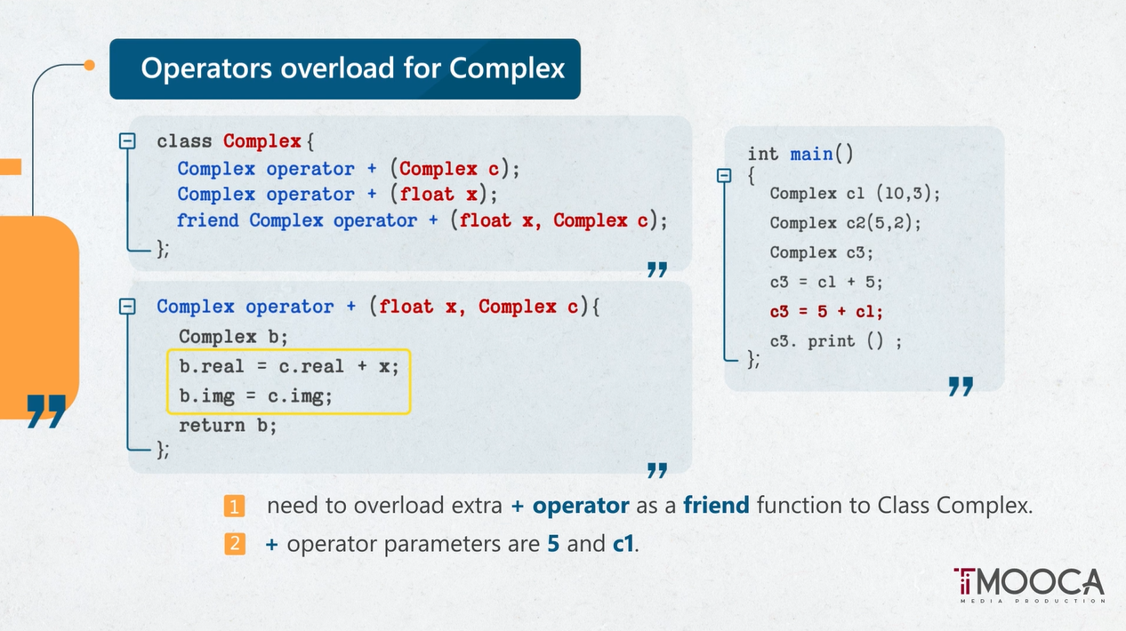

Slide 17
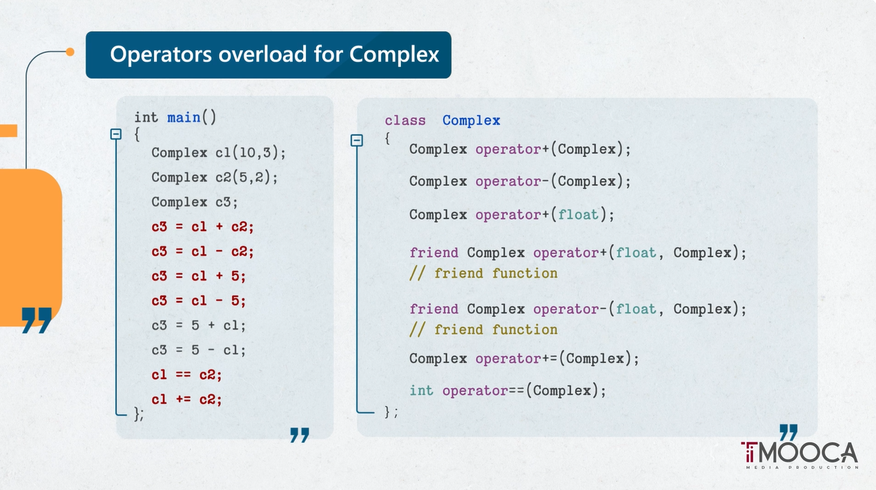

Slide 18
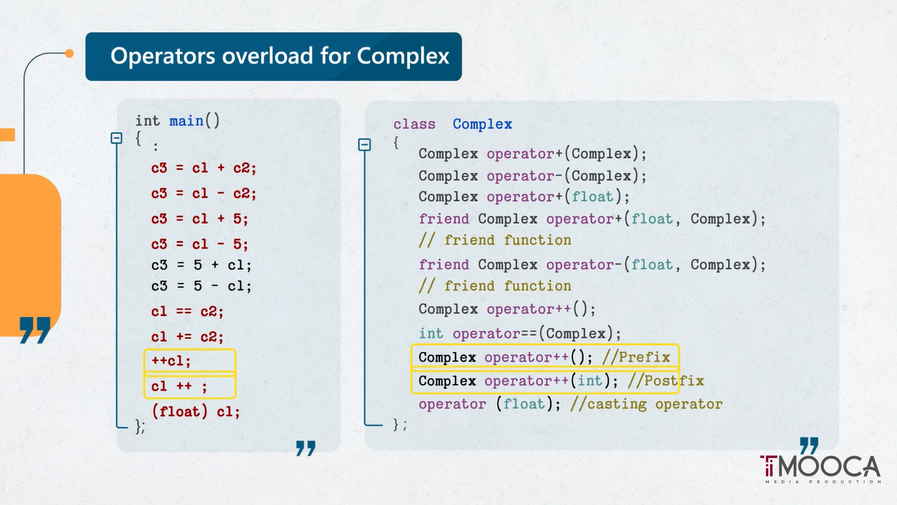

Slide 19
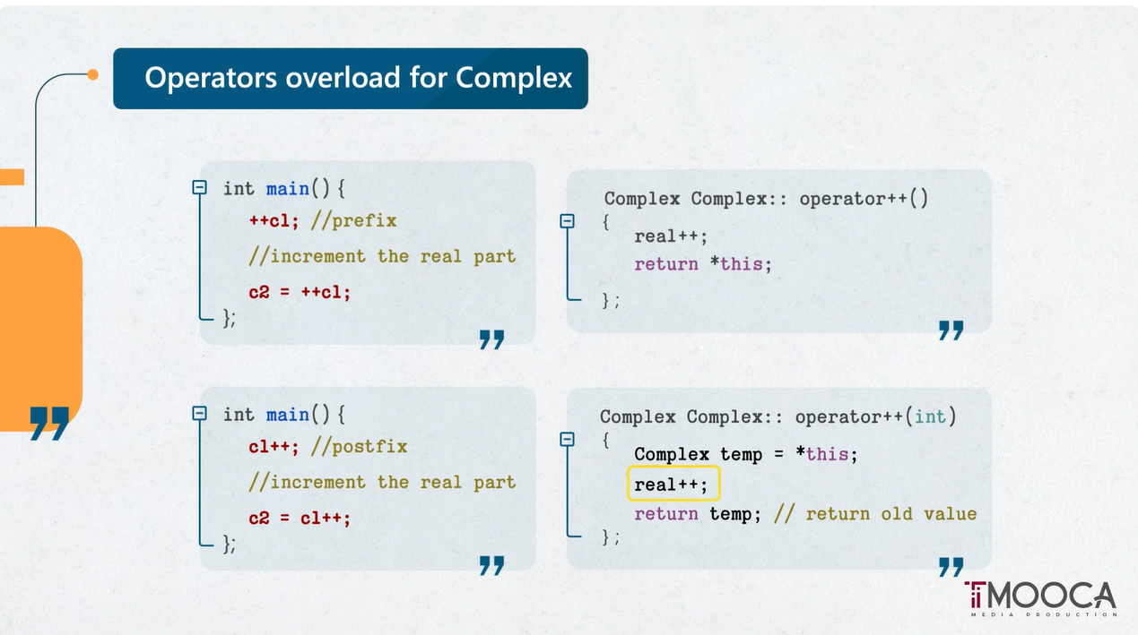

Slide 20
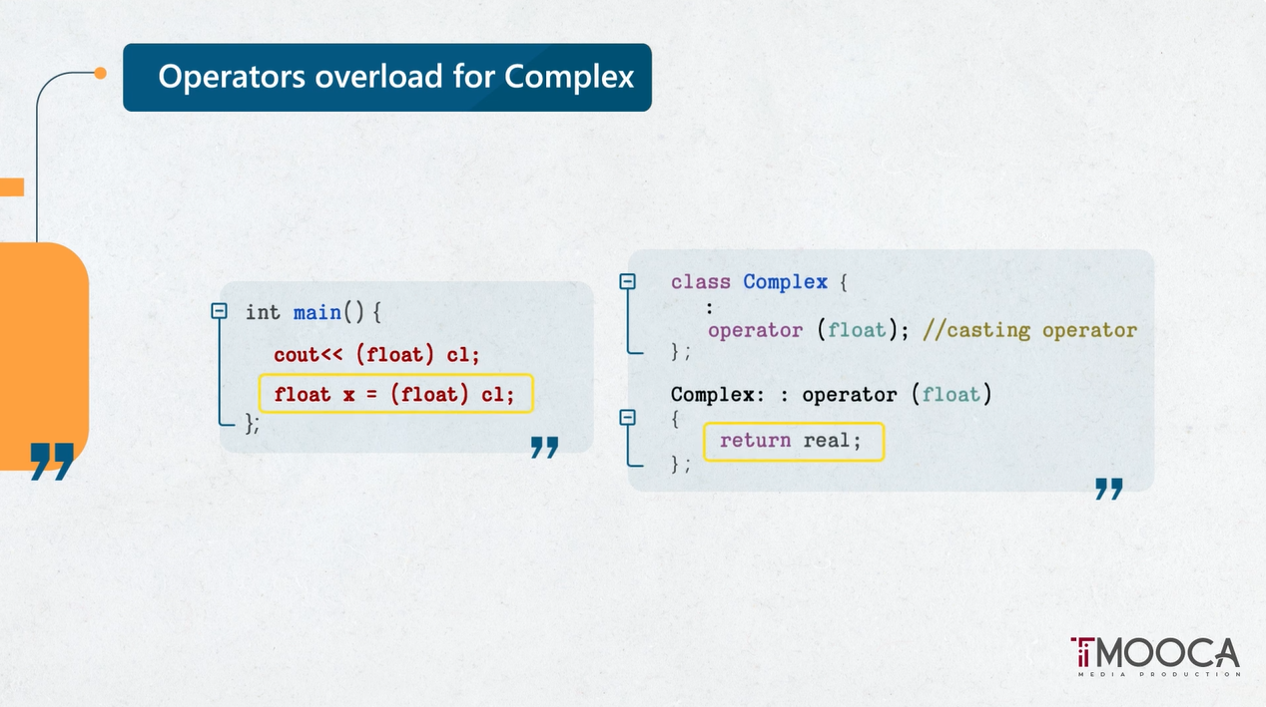

Slide 21
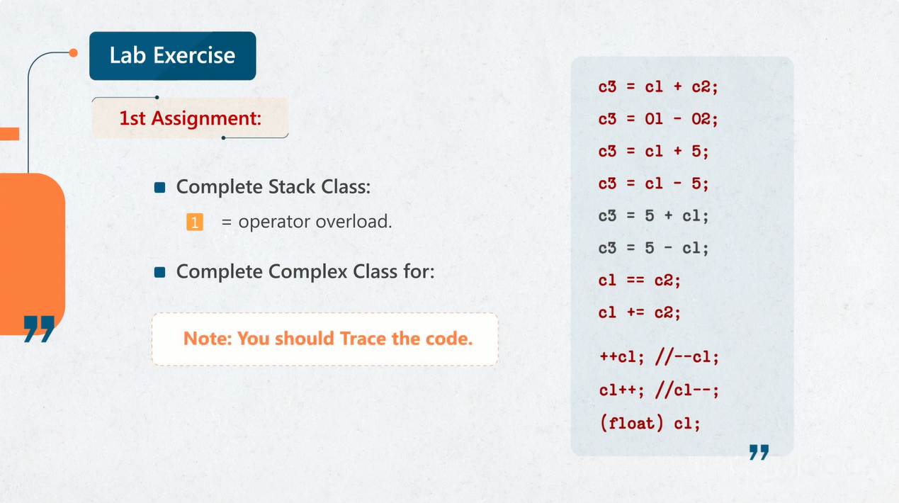

Slide 22
Thanks

